Slide 1
FLASK MICRO FRAME WORK
What is Web Framework?
Web Application Framework or simply Web Framework represents a collection of libraries and modules that enables a web application developer to write applications without having to bother about low-level details such as protocols, thread management etc.
WSGI
Web Server Gateway Interface (WSGI) has been adopted as a standard for Python web application development. WSGI is a specification for a universal interface between the web server and the web applications

Slide 2
FLASK ISTALLATION
virtualenv is a virtual Python environment builder. It helps a user to create multiple Python environments side-by-side. Thereby, it can avoid compatibility issues between the different versions of the libraries.
pip install virtualenv
We are now ready to install Flask in this environment.
pip install Flask

Slide 3
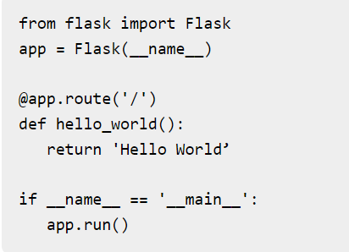
SAY FLASK TO HELLOW
In order to test Flask installation, type the following code in the editor as Hello.py
Importing flask module in the project is mandatory. An object of Flask class is our WSGI application.
Flask constructor takes the name of current module (__name__) as argument.
The route() function of the Flask class is a decorator, which tells the application which URL should call the associated function

Slide 4
PARAMETERS AND DESCRIPTION
1 | host Hostname to listen on. Defaults to 127.0.0.1 (localhost). Set to ‘0.0.0.0’ to have server available externally
2 | port Defaults to 5000
3 | debug Defaults to false. If set to true, provides a debug information
4 | options To be forwarded to underlying Werkzeug server.

Slide 5
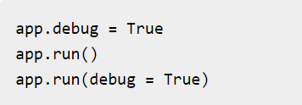
Debug mode
A Flask application is started by calling the run() method. However, while the application is under development, it should be restarted manually for each change in the code. To avoid this inconvenience, enable debug support. The server will then reload itself if the code changes. It will also provide a useful debugger to track the errors if any, in the application.
The Debug mode is enabled by setting the debug property of the application object to True before running or passing the debug parameter to the run() method.

Slide 6
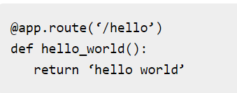
Flask – Routing
Modern web frameworks use the routing technique to help a user remember application URLs. It is useful to access the desired page directly without having to navigate from the home page.

Slide 7
FLASK-HTTP METHODS
Methods & Description
1 | GET Sends data in unencrypted form to the server. Most common method.
2 | HEAD Same as GET, but without response body
3 | POST Used to send HTML form data to server. Data received by POST method is not cached by server.
4 | PUT Replaces all current representations of the target resource with the uploaded content.
5 | DELETE Removes all current representations of the target resource given by a URL

Slide 8
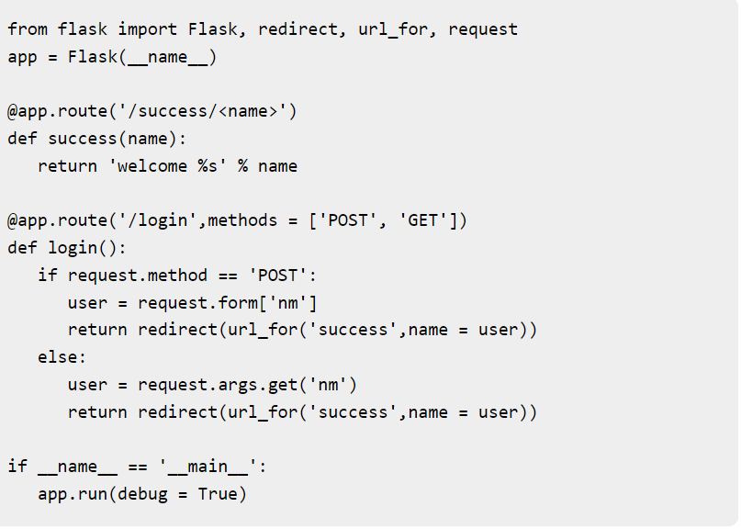
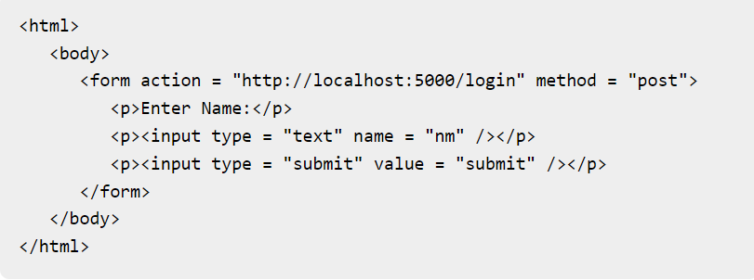
CODE FOR GET AND POST

Slide 9
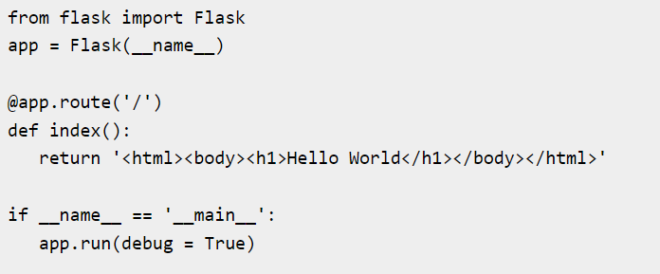
FLASK TEMPLATES
It is possible to return the output of a function bound to a certain URL in the form of HTML. For instance, in the following script, hello() function will render ‘Hello World’ with <h1> tag attached to it.

Slide 10
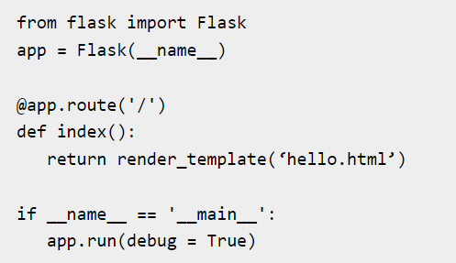
RNEDERING HTML
However, generating HTML content from Python code is cumbersome, especially when variable data and Python language elements like conditionals or loops need to be put. This would require frequent escaping from HTML.
This is where one can take advantage of Jinja2 template engine, on which Flask is based. Instead of returning hardcode HTML from the function, a HTML file can be rendered by the render_template() function.

Slide 11
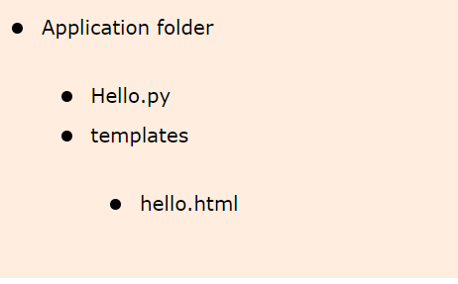
STRUCTURE OF FINDING TEMPLATES
Flask will try to find the HTML file in the templates folder, in the same folder in which this script is present.

Slide 12
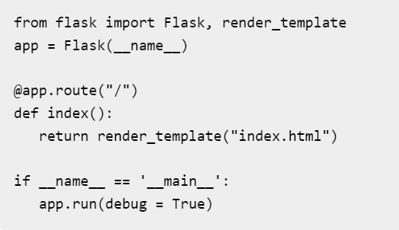
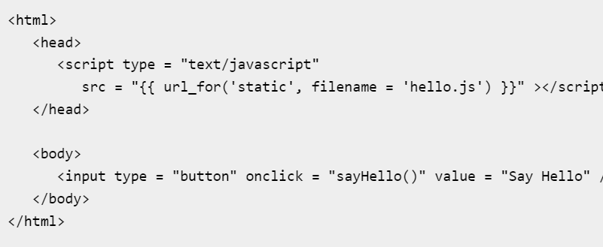
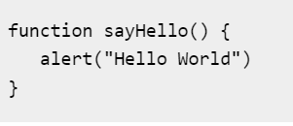
FLASK STATIC FILES
A web application often requires a static file such as a javascript file or a CSS file supporting the display of a web page. Usually, the web server is configured to serve them for you, but during the development, these files are served from static folder in your package or next to your module and it will be available at /static on the application.

